Slide 1
Hospital Considerations for the Care of Highly Hazardous Infectious Diseases
Keith F Hansen, MBA
College of Public Health
University of Nebraska Medical Center
March 20, 2019

Slide 2
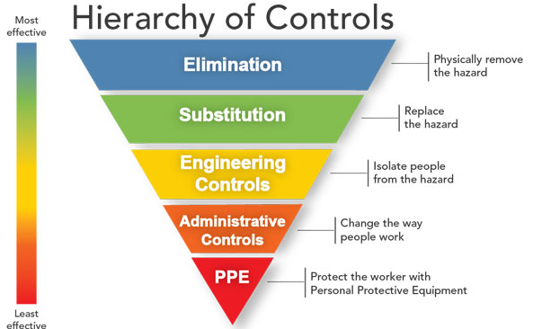

Slide 3
Hot (Red) Zone
Red Zone
Sometimes called the hot zone or exclusion zone
Most contamination. Dirty patients, blood, body fluids, equipment and supplies are here
Caregivers are ALWAYS in PPE

Slide 4
Warm (Yellow) Zone
Yellow Zone
Sometimes called the warm zone or contamination reduction zone
Transition are between hot (red) and cold (green) zones
Where PPE doffing occurs
Labs and/or waste hand off into a second container/bag
Equipment wided down

Slide 5
Cold (Green) Zone
Green Zone
Sometimes called the cold zone
Free from all contamination
Can be used to stage personnel equipment and supplies
Also used for donning PPE

Slide 6
Controls

